Slide 1
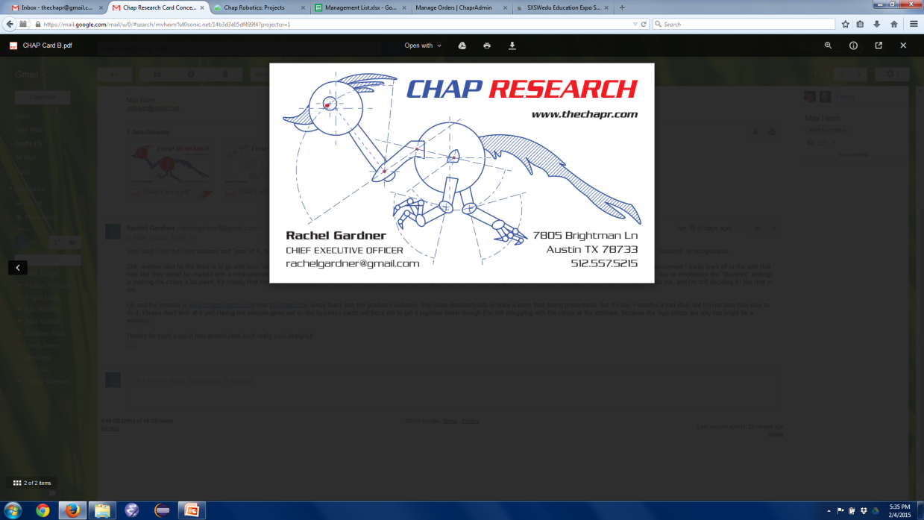
1st Board of Advisers Meeting
2/7/15

Slide 2
What is Chap Research?
A framework for innovation
An innovation program to give Westlake students the opportunity to learn real world technical skills not taught in school
An opportunity for students to experience and participate in research and design
A way of linking students to mentors in the community to inspire and support student innovation

Slide 3
Why Make Chap Research?
Give students the experience and confidence to succeed in college and career settings
Helping them start from scratch
Bridging the gap between coursework and “work work”
Allow students to further explore/develop industry-applicable skills that are *not* taught in school
Pitching to “investors”
Working with customers
Developing ideas
Marketing products
Managing others
Applying for patents
Project endurance
Etc.

Slide 4
Why Make Chap Research?
Let students try stuff
Explore career choices
Become dedicated/involved in STEM
Let students stand out
Getting patents, press coverage etc. for individuals
Create a model to serve as inspiration for similar innovation programs at the high school level

Slide 5
What Does It Look Like?
A “framework” of support
Meets after school (usually at the high school)
Mentors, finances, facilities, equipment
Skill-building seminars (either adult or student led)
Several concurrent projects
Actively searching for new projects/patents
Either (experienced) student or mentor led
Teaching entrepreneurial skills
Allowing student leadership (building management skills)
Documented on website (also to create precedent/continuity within program)
Industry cooperation
Connect projects/problems with industry individuals
End products/deliverables
“Sellable” products (the ChapR)
Patents
Publications
Presentations (ChapX, Champs Conference)

Slide 6
The Vision
Get a grant (or any form of funding, however small)
Publish whitepapers, articles etc.
Contribute something (however small) to knowledge basis
Sustainable
Students continue with program from beginning to end
Still in place for alumni to see when they visit
Replicable
Another school/team creates a similar program
Recognition from Westlake
Chap Recap announcements
Recruiting table at orientation
Between 10 and 20 students

Slide 7
Adult Motivators
—mentors, board members, supporters—
Want to give back to the community (local focus)
Enjoy teaching
Live vicariously through students
enjoy making the products/projects

Slide 8
Student Motivators
Experience not given by school curriculum
Kudos from peers/mentors/community
Responsibility to peers/mentors
College app and resume builder
Patents, publications, job titles
Networking with industry professionals
Desire to see projects to completion

Slide 9
Management Structure
Board of Directors
A group of teachers and mentors whom the students report to on a weekly or monthly basis
Builds accountability
Gives practice presenting/selling ideas
CEO/Manager
One student held personally responsible for the success of the program
Project Leads
One student per project who is held responsible for the success of the project
Gives brief reports on respective projects at board of directors meetings
Individual Contributors
Members of individual subgroups, held responsible for meeting deadlines and small portions of their projects
Notes:
Schools are constantly telling us that everyone is equal and we are all peers, but that is not at all how companies operate
We need experience operating in a management structure

Slide 10
What do we want from the board?
Material Review
Review of presentations, future publications etc.
General Advice
Project ideas
Stewardship
Force us to be accountable
Financial oversight
Credibility
Working with important people will draw more support
A Learning Opportunity
Let high school students learn to work with a board
Connections
More mentors
Facilities?
Equipment
Money?

Slide 11
Who else should be on the board?
Venture capital stuff, management help, software/electrical engineering
Eric Rothfus
Marketing, management, industry networking
Scott Gardner
Educator/general networking, student management/teaching
Norman Morgan
University networking (for professors and facilities), computer science help
Dr. Warren Hunt (Professor of Computer Science at UT)
Big-name college/university? - ?
Industry connections (internships/grants/facilities/mentors), type one expertise - ?
Industry connections (internships/grants/facilities/mentors), type two expertise - ?

Slide 12
Current Status

Slide 13
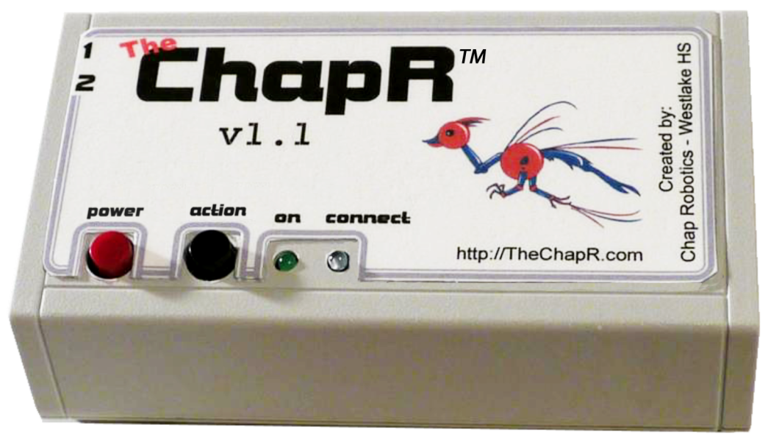
The ChapR
Customer webpage - www.thechapr.com
Orders database - http://orders.thechapr.com
129 shipped
11 Charity, 118 Sold
49 orders
6 Charity, 43 Sold
FRC compatibility in alpha

Slide 14
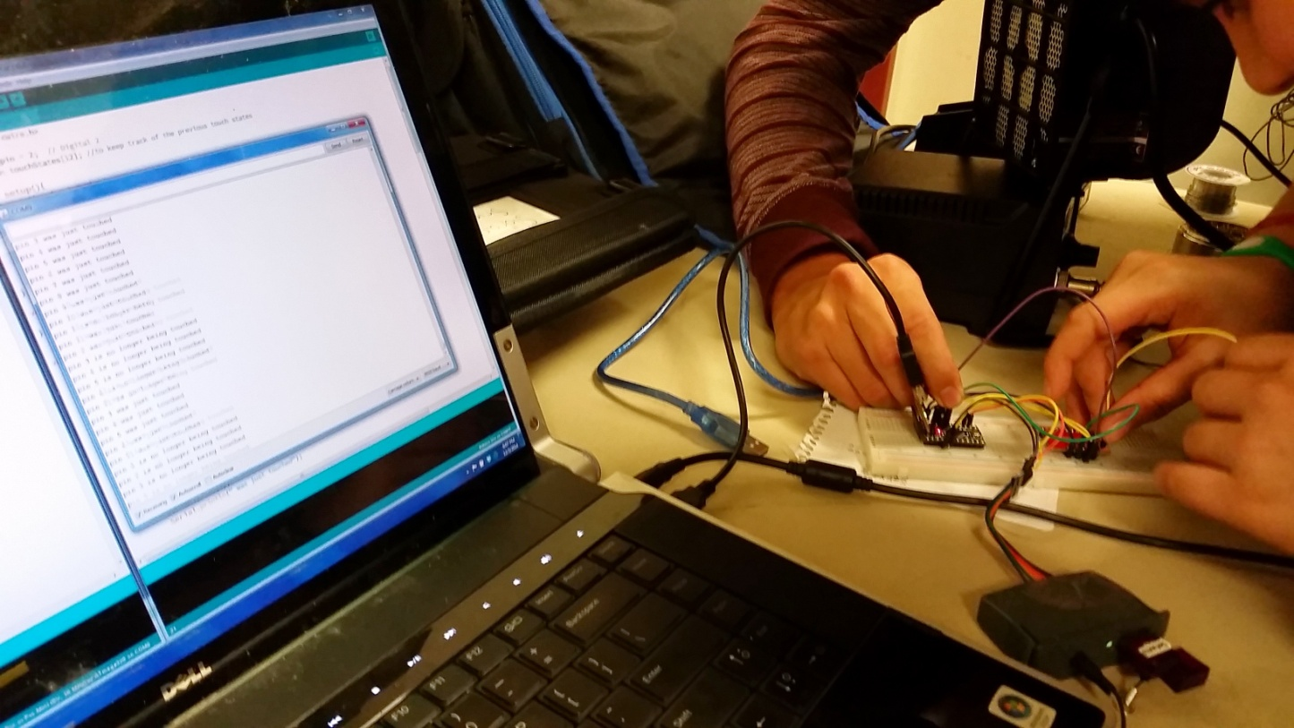
TedEx Labs Project
A spiral or basket of fruit to be used as touch sensors
Has “BopIt”, “Simon” and “Space Game” modes
Presentation Feb 14th at TedEx

Slide 15
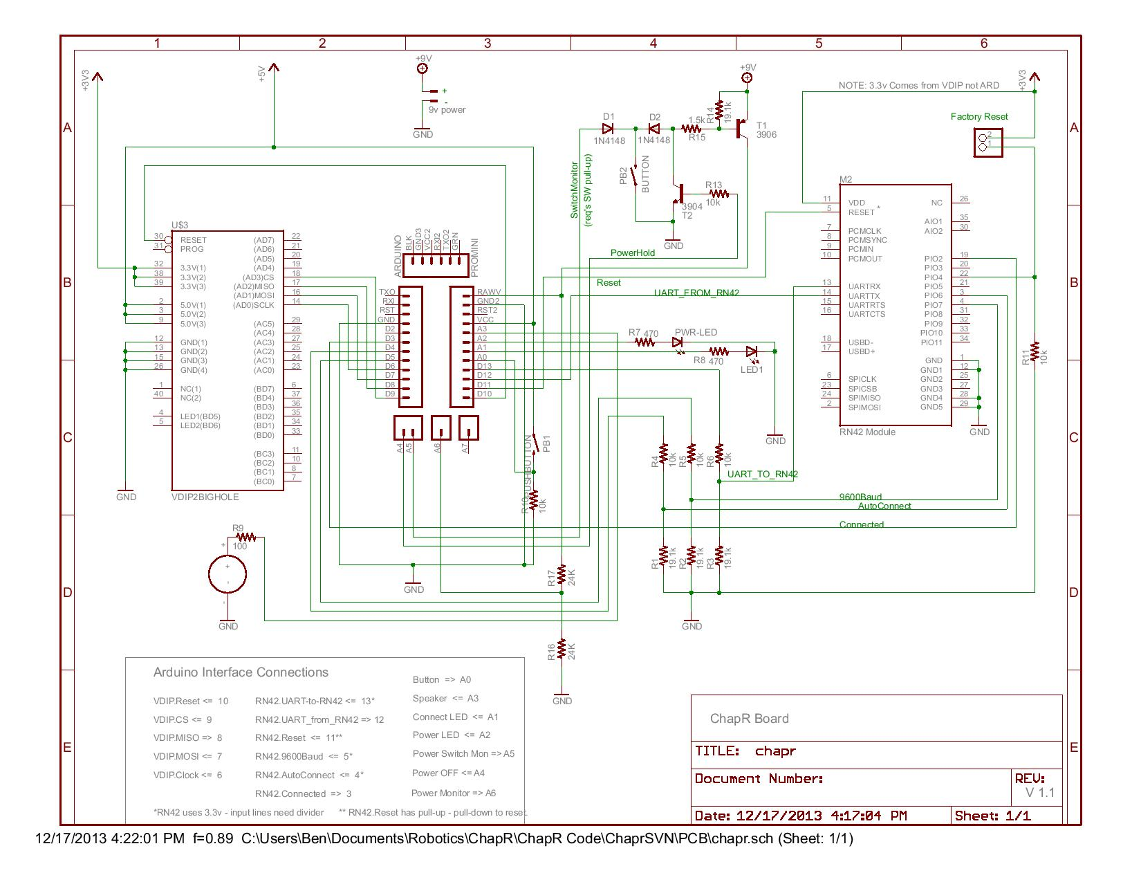
MXP BeatBoard
Separates sound into frequency bands
Could used to flash LEDs or actuate motors

Slide 16
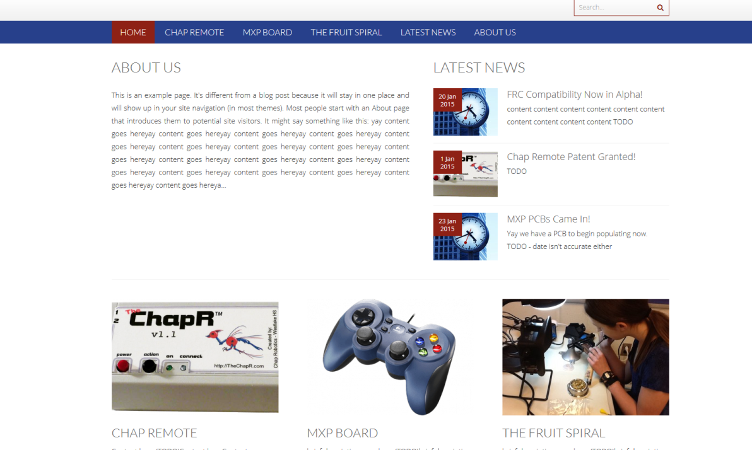
Chap Research Website
www.chapresearch.com
Live, but empty of content
Logo still in development
Will be filled based on results of this meeting

Slide 17
Start Up Scholarship
SXSWedu Education Expo Student Startup Competition
Due Sunday February 22nd
Winners present at SXSW and receive a “startup scholarship”

Slide 18
Office “Renovation”
Cleaned out the programming cave
Happily share the space with whoever works quietly
Will continue adjusting/cleaning

Slide 19
Succession
Looking to begin “teaching days”
May post “job openings” in Featherduster

